Slide 1
IHTIMAM "Site Crew Training"

Slide 2
Introduction
Safety Induction / Safety Moment ..
Why are we here ?
Why the change from STOP ?
IHTIMAM pilot ?
Notes:
Firstly introduce yourself, shake their hand and create a friendly open atmosphere. Give your name and designation and allow whomever is assisting you to do the same.
Do the Safety Induction / share or ask the team to share any safety moments/observation, etc..
Inform them that you are here today to train them on Ihtimam, and that it is an interactive session and you would appreciate their participation.
Allow them to introduce themselves to you and try to make a point to remember their names.
Inform them that you will now start the training.
Be sure that you inform them of any critical safety information (fire exits, drills, smoking areas etc depending on where you are hosting the training.
Lets begin:
Would you agree that we work in a hazardous environment? Are there many risks around us? Do we have measures in place to mitigate these risks? So why do we still have incidents?
Is it peoples behaviors? 98 % of incidents occur due to peoples behaviors. However that is the IMMEDIATE cause and not the root cause. If you were to dig deeper you would find several contributing factors from behaviors, to equipments that contributed to the incident.
Previously Behavior based safety (STOP or equivalent) only looked at behaviors of an individual, as time has passed, BBS has evolved. It has become about a cultural change rather than 1 persons behavior. And that is what I am here to explain to you today.
Changes between STOP and Ihtimam
STOP:
ONE FITS ALL APPROACH.
FOR FIELD STAFF ONLY.
ORIGINALLY LIMITED TO SUPERVISORS.
GENERIC OBSERVATION CARD.
OBSERVATION CARDS NOT FOCUSED.
TRAINING SPECIFIC FOR SUPERVISORS CASCADED TO ALL STAFF.
PRODUCT DILUTION OVER TIME.
DATABASE NOT USER FRIENDLY.
NO ACTION TRACKING.
QUANTITY OVER QUALITY.
Ihtimam:
CUSTOMIZED APPROACH.
INCLUDES OFFICE PERSONEL.
VERY SIMPLE.
DESIGNED THROUGH ENGAGEMENT OF STAFF.
OBSERVATION CARDS ARE LIMITED TO 5 FOCUS AREAS.
OWNERSHIP OF SYSTEM WITH SUPERVISOR.
COMPREHENSIVE ONLINE DATABASE.
ONLINE ACTION TRACKING.
TRAINING SPECIFIC TO AUDIENCE.
5 LEADING KPI’S MEASURE EFFECTIVENESS
Ihtimam Pilot
Ihtimam has already been piloted in (Rig97/95, Hoist 103/105, Carillion Nimr and Marmul ) and has proven to be very successful. People appreciated its simplicity, its improvement in communication and the fact that it was not focused on an individual but on the root causes, and more importantly that actions were getting closed out and monitored.
As Ihtimam is a product that has been created jointly between PDO and Contractors, PDO BBS team is always open to hearing your suggestions to help it work for you. So keep that in mind throughout the training and you can let me know if you would like to share something at any time.

Slide 3
Behavior Based Safety
What is Behavior Based Safety?
An Observation process (a way to understand why people behave the way they do)
A collection data tool to study the quality of the company's safety management system
The way we do things around here. (Our Safety Culture)
Notes:
An observation process, which is basically the observation cycle (Observe, Feedback, Document, Close Actions, Analyze). It is our means to understand why people do what they do and try to eliminate root causes.
The way we do things around here….do we mean what we say? Do we walk the talk? Is safety really a priority or something we must do? do we own safety? Do we set standards above the minimum requirements? Do employees believe what we tell them?
The database gives us the ability to upload and store data for analysis, if we analyze the right things we will be able to determine our gaps, concerning behaviors, and our overall performance. It is also an essential piece to our continuous improvement.

Slide 4
Safety Culture
Psychological Factor
Leadership
Behavioral Factor
How people think and feel about safety. Their beliefs & attitudes.
What do we actually do on a daily basis to improve safety
Hearts & Minds
Daily Actions
Safety Leadership
Management Systems
Situational Factor
This is what the organization does to control safety, and involves a wide number of things such as the physical environment, management systems, communication, monitoring and controls, resources etc.
By Dominic Cooper

Slide 5
Behavior Based Safety
What Behavior Based Safety is NOT ?
Only about observations and feedback
Concerned only about the behaviors of line employees
Focused on incident rates
A substitution for traditional risk management techniques
Manipulation and blaming of people
A process that does not require employee engagement & employment
Notes:
Many people think BBS is only about observation and cards, this is far from what BBS actually is. BBS should be viewed from a wider angle, to benefit the entire organization. Not just one individual who probably behaved the way he did for a reason. BBS is progressed to focus more on management systems and the working interface instead of the individual.
As mentioned in the previous slide, BBS is about how we do things around here, and that means everyone in the organization, safety effects as all.
Incident rates should not define a BBS system, BBS is focused on people and understanding why they do the things that they do, many additional components can contribute to an incident regardless whether people are trained in BBS or not.
Just as the previous point, BBS will not stop incidents from occurring if other factors are not well controlled. We cannot have employees in an unsafe environment working with unsafe equipment and expect them not to have an incident because you have a BBS system in place.
BBS is a no blame process, workers do not intend to harm themselves, blaming the worker or manipulating someone who raises an observation against you will not help you, the individual or the organization in reducing incidents.
BBS involves everyone, from top management, mid management and the front line workers, without one, the company would not cease to stand, and therefore everyone needs to be onboard in the pro-active effort to reaching sustainable excellence. Involving stakeholders is key in anything you do, and 90% of the time the stakeholders are your frontline workers.

Slide 6
STOP VS Ihtimam
STOP
IHTIMAM
STOP
ONE FITS ALL APPROACH
FOR FIELD STAFF ONLY
ORIGINALLY LIMITED TO SUPERVISORS
GENERIC OBSERVATION CARD
OBSERVATION CARDS NOT FOCUSED
TRAINING SPECIFIC FOR SUPERVISORS CASCADED TO ALL STAFF
PRODUCT DILUTION OVER TIME
DATABASE NOT USER FRIENDLY
NO ACTION TRACKING
QUANTITY OVER QUALITY
CUSTOMIZED APPROACH
INCLUDES OFFICE PERSONEL
VERY SIMPLE
DESIGNED THROUGH ENGAGEMENT OF STAFF
OBSERVATION CARDS ARE LIMITED TO 4 - 6 FOCUS AREASTO
OWNERSHIP OF SYSTEM WITH SUPERVISOR.
COMPREHENSIVE ONLINE DATABASE
ONLINE ACTION TRACKING
TRAINING SPECIFIC TO AUDIENCE
4 LEADING KPI’S MEASURE EFFECTIVENESS
Notes:
The development of Ihtimam was a 3 year journey. It began in Aug of 2015 when steer from PDO directors steering committee gave direction to develop a in house behavior based system for PDO and its contractors. As there was many frustrations with previous systems that did not work.
The Behavioral safety team began to assess previously used BBS systems within PDO as well as: deep dive reports, safety culture reports, visits to site, engagements with contractors, and review of several BBS case studies and best practices.
A blue print was then presented in March 2016 and was endorsed by the PDO directors steering committee.
In January of 2017 the PDO BBS team along with 3 other contractors launched a pilot in 6 locations at site for 8 months.
At the end of the 8th month a sustainability review was conducted that proved the success of the system and endorsement was given to start rolling it out across the organization.

Slide 7
Fundamentals of Ihtimam
Observe
01
CI
Feedback
06
02
01
Observe
Close Actions
Observe an individual or group.
04
Close actions related to the observation.
02
Feedback
Analyse
Give constructive feedback, with the attempt to identify the root cause.
Analyze the data periodically for areas of improvement.
05
Analyze
05
Document
03
Close Actions
04
Continuously Improve
Document
06
03
Document the observation in the database
Enhance the system in order to improve ease of use, and efficiency.
Notes:
Now that we covered the ABC analysis and have an understanding for behaviors we will move onto the foundations of Ihtimam.
The IHTIMAM observation cycle consists of 6 main steps.
1 – Observation
2 – Giving feedback
3 – Data capture
4 – Closing out actions
5 – Analysis of data
6- Continuously Improve

Slide 8
Determining Success (KPIs)
Corrective Actions Completed
Percent Safe Scores
Quality Observations
Quality Feedback

Slide 9
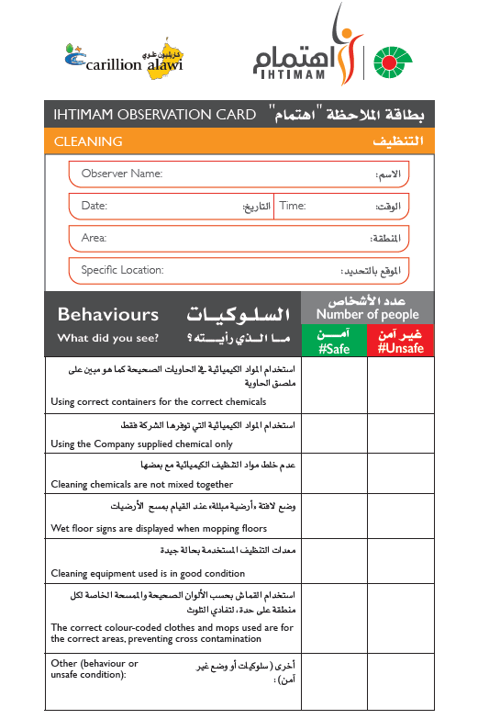
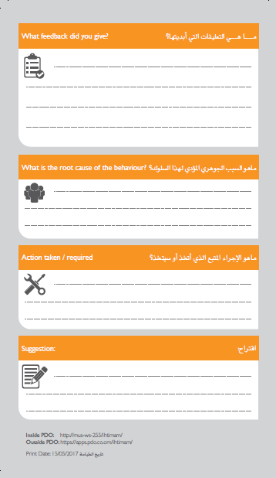
Observation card
Each observation card is limited to 5 to 6 specific behaviors. This makes it easy
for employees
to focus on the critical behaviors
Notes:
Explain the elements of the card
Explain the ways to document the observation cards ( Phone , PC , Hard copy )

Slide 10
Conducting a Successful Observation
Don’t Hide let the person or people you are observing know you are there. It is normal to wonder, “If they know I am there, they might do everything right.” One of the goals should be to help create new habits, not to catch a rule violator.
Observe “Can the employee perform the task safely?”.“Do I see anything that concerns me?”
Your observation should find if workers can perform the task safely. You should proactively identify concerns that might increase the chances of an injury. Observations should not be used as a faultfinding opportunity.
Ask If you see a safe precaution being taken or an exposure to risk, ask the most appropriate questions. For example: Why did you do it that way? Is that the way you always do it? Do you feel safe doing it that way? Is there a safer way to do it? Were you trained to do it that way?
Reinforce importance should be placed on reinforcing what the worker is correctly doing to ensure that s/he is not just being lucky when it comes to injury prevention. If an individual has performed a discretionary precaution while performing the work, this is an excellent time to reinforce precisely what you observed and encourage him/her to continue.
Express concern when a risk is identified during an observation, expressing concern is a preferred approach rather than stating someone is “at risk” and “unsafe. If we do not show concern the individual may get defensive. If you show concern with how a task is performed, this offers a better chance for a conversation leading to an understanding of why risk is a part of the task.
Notes:
Please conduct a role play to make this part clear to your audience
Choose the scenario based on the type of activities you have to pass a clear information on the way to intervene and approach people .

Slide 11
Congratulations!
You have completed the IHTIMAM Site Crew Training

